Slide 1

ELECTRONICS 101
Multimeter

Slide 2


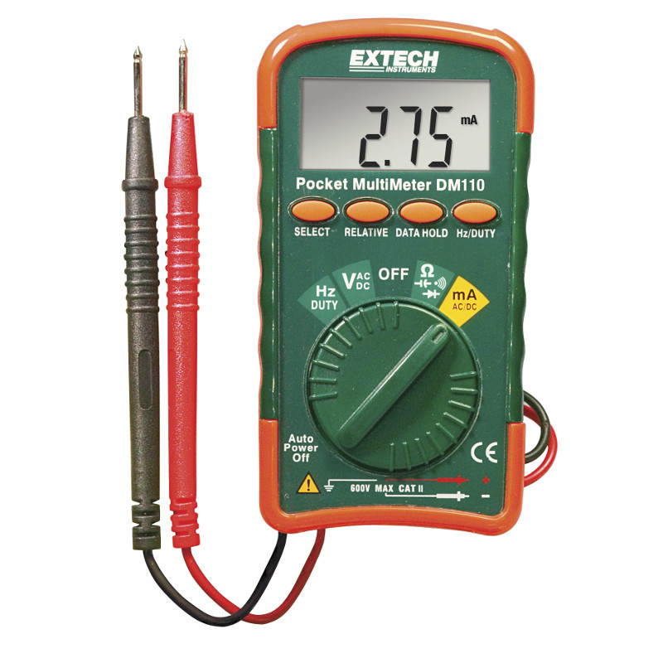
What is a Multimeter?
A measuring device that allows you to measure different parts of electricity and different components
Voltage, current, frequency, and temperature are the parts of electricity
Resistance, capacitance, and inductance are different components
Comes in either auto or manual range

Slide 3
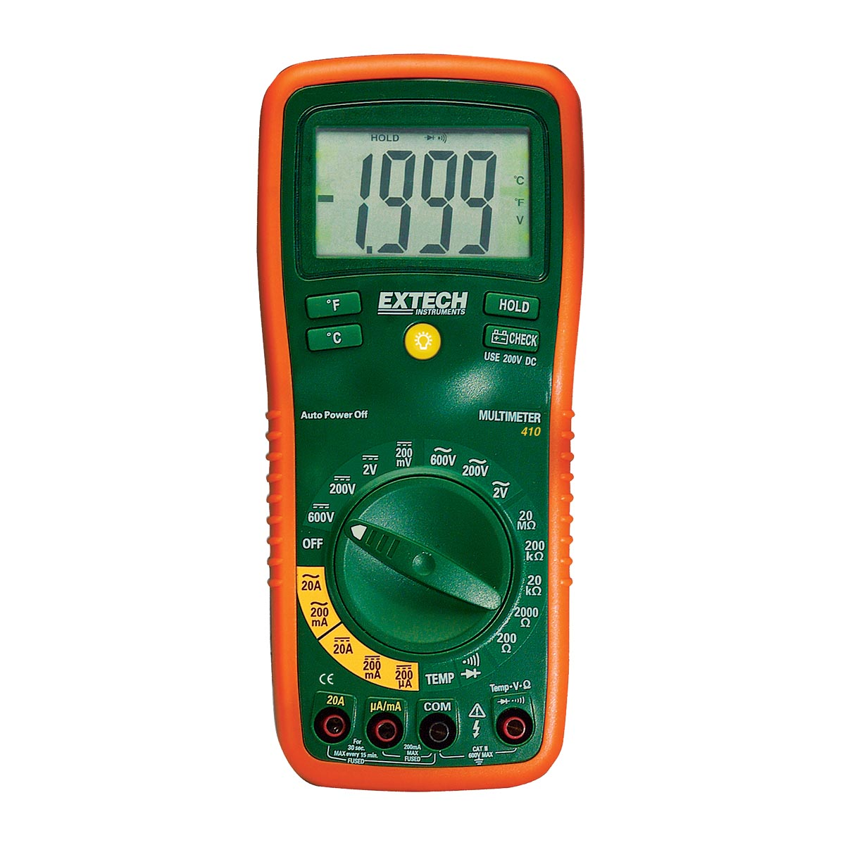
Manual Range Vs. Auto Range
Manual range multimeter allows you to adjust the range of the measurements manually
ex. if you are measuring the voltage of wall outlet, make sure you adjust it to 100v setting
Auto range multimeter allows you to measure while the multimeter automatically adjust the measurement range
ex. if you are measuring the voltage of a wall outlet make sure you adjust the multimeter to AC voltage setting

Slide 4

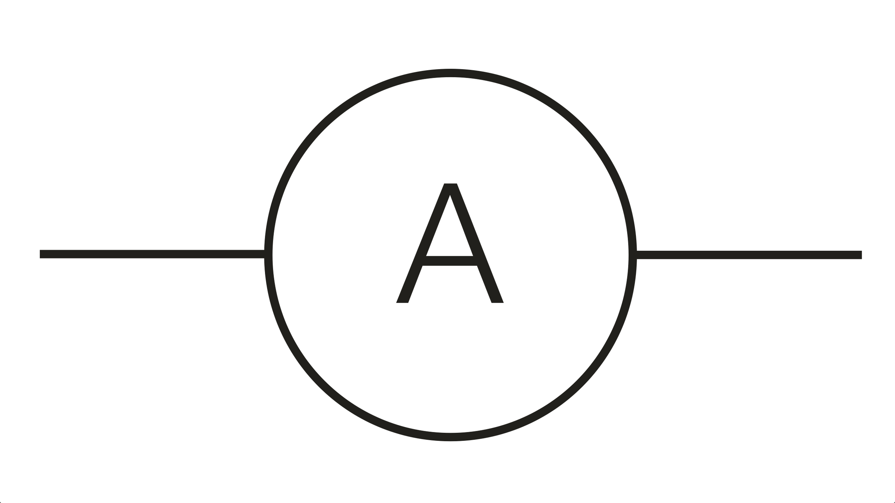
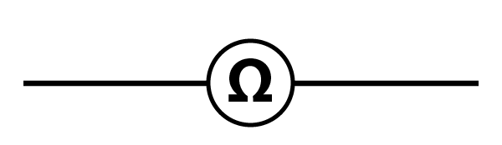
Different types of -Meters in Multimeters
Volts - Voltmeter
Amps - Ammeter
Ohms - Ohmmeter

Slide 5
How do you use a Multimeter?
Depends on whether you are measuring voltage, current, and resistance
Adjust the multimeter accordingly
voltage
put any positive lead at any point in the circuit and put the negative lead to ground
current
put positive lead on one end of the component/wire and the negative lead to another end of another component/wire
resistance
take a resistor and put positive lead on one end and the negative lead on the other end

